Slide 1
Brain Tumor Detection using Neural Networks
NN Project
Batch: EC3
Team Members:
Aaqil Modak – C063
Esha Shah – C093
Sachi Shah – C094

Slide 2
Introduction
Problem definition
Proposed System Algorithms /Architecture
Implementation and Discussion (Work done)
References
Roadmap

Slide 3
Introduction
According to the International Agency for Research on Cancer (IARC), the mortality rate due to brain tumors is 76%. It is required to detect the brain tumors as early as possible and to provide the patient with the required treatment to avoid any fatal situation.
With the recent advancement in technology, it is possible to automatically detect the tumor from images such as Magnetic Resonance Imaging (MRI) and computed tomography scans using a computer-aided design.
Machine learning and deep learning techniques have gained significance among researchers in medical fields, especially Convolutional Neural Networks (CNN), due to their ability to analyze large amounts of complex image data and perform classification.

Slide 4
Introduction
Brain tumor detection is important for several reasons:
Early detection: can help healthcare professionals begin treatment before the tumor grows too large or spreads to other parts of the brain. This can increase the chances of successful treatment and improve the patient's prognosis.
Accurate diagnosis: of the type and location of the tumor. This information is critical for determining the most appropriate course of treatment and developing a treatment plan tailored to the patient's individual needs.
Monitoring Tumor growth

Slide 5
Brain tumors can be life-threatening and can cause a range of debilitating symptoms. Early detection and accurate diagnosis of brain tumors are crucial for effective treatment and management of the condition. However, traditional methods of brain tumor detection, such as medical imaging, are often limited by factors such as cost, availability, and accuracy. Therefore, there is a need to develop new, more efficient and accurate methods for brain tumor detection, such as artificial intelligence and machine learning algorithms, that can help healthcare professionals detect brain tumors early and provide more targeted treatment options for patients.
Problem Definition
Hence we created, A MODEL THAT DETECTS THE BRAIN TUMOR USING NEURAL NETWORKS.

Slide 6
Proposed System Algorithms /Techniques
The algorithm that is used to train data are as follows :
CNN: A convolutional neural network (CNN) is a type of artificial neural network used primarily for image recognition and processing, due to its ability to recognize patterns in images. A CNN is a powerful tool but requires millions of labelled data points for training
Data Augmentation: Data augmentation is a technique of artificially increasing the training set by creating modified copies of a dataset using existing data. It includes making minor changes to the dataset or using deep learning to generate new data points.

Slide 7
Proposed System Algorithms /Techniques
The algorithm that is used to train data are as follows :
Adam Optimizer: Adam optimizer is the extended version of stochastic gradient descent. The name is derived from adaptive moment estimation. Adam is an algorithm for optimization technique for gradient descent. It requires less memory and is efficient. Intuitively, it is a combination of the ‘gradient descent with momentum’ algorithm and the ‘RMSP’ algorithm.

Slide 8
Implementation and Discussion
Why was Data Augmentation done?
Since we had a small dataset, there weren't enough examples to train the neural network. Also, data augmentation was useful in tackling the data imbalance issue in the data (since 61% of the data belonged to the tumorous class).
Before data augmentation, the dataset consisted of:
155 positive and 98 negative examples, resulting in 253 example images.
After data augmentation, now the dataset consists of:
1085 positive and 980 examples, resulting in 2065 example images.

Slide 9
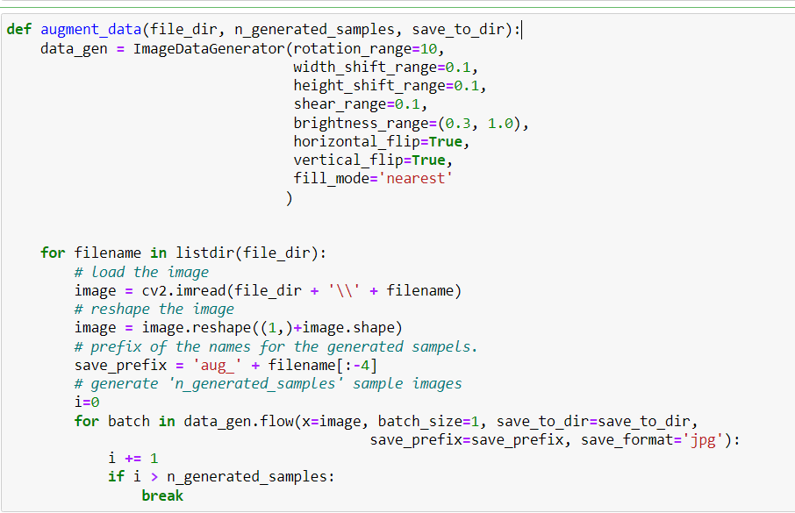
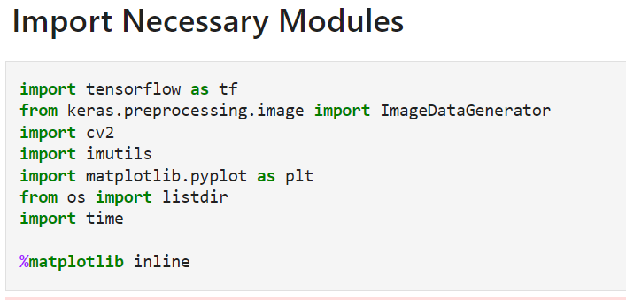
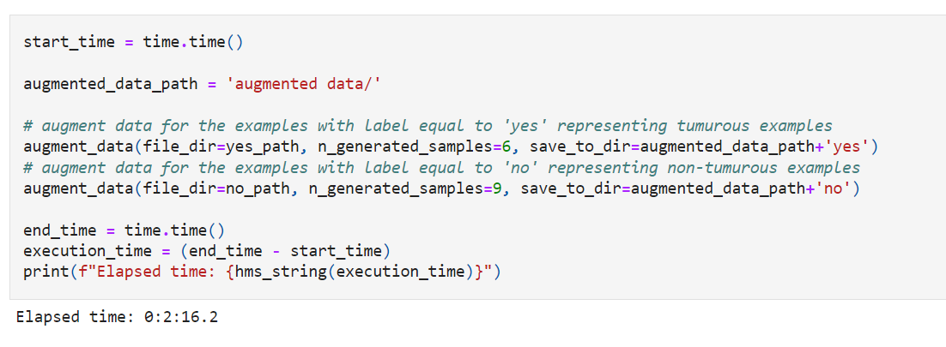
Since 61% of the data (155 images) were tumorous. And, 39% of the data (98 images) were non-tumorous.
So, in order to balance the data we can generate 9 new images for every image that belongs to 'no' class and 6 images for every image that belongs the 'yes' class.

Slide 10
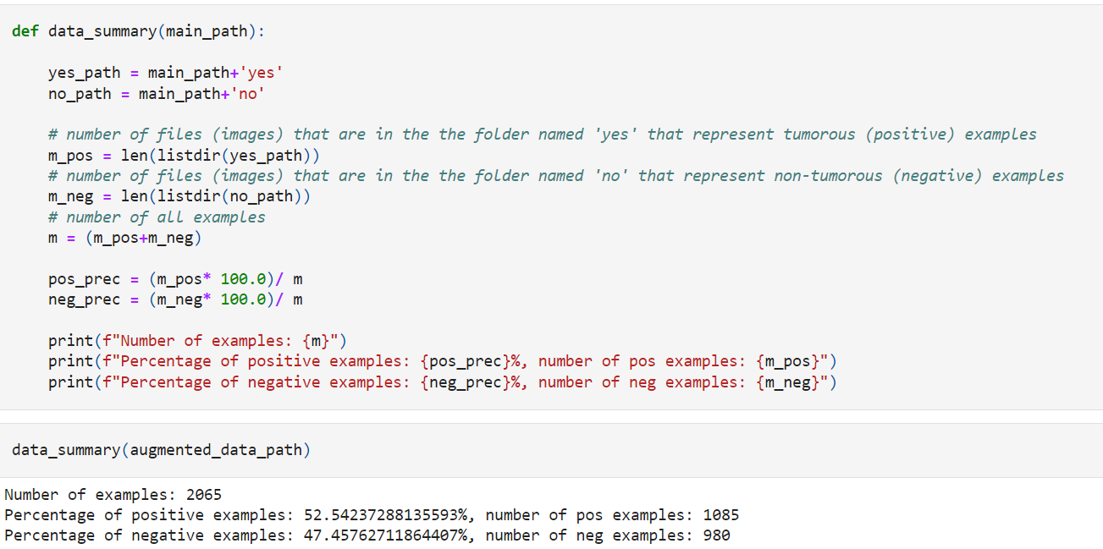
Performing Data Augmentation
Now, we used the augmented data to train our convolutional neural network.

Slide 11
Implementation and Discussion
Implementation
Data Preparation & Preprocessing
Crop the part of the image that contains only the brain (which is the most important part of the image).
Resize the image: because images in the dataset come in different sizes. So, all images should have the same shape to feed it as an input to the neural network.
Apply normalization: to scale pixel values to the range 0-1.
Data Split
70% of the data for training.
15% of the data for validation.
15% of the data for testing.
Model Building
Results Interpretation

Slide 12
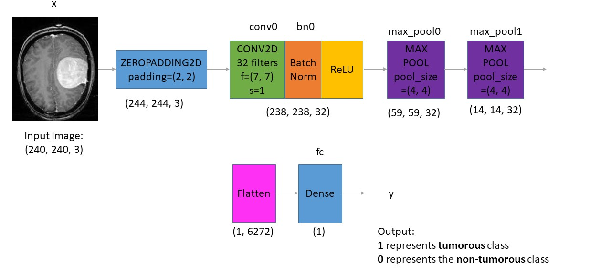
This is the architecture that we’ve built:
Notes:
Understanding the architecture: Each input x (image) has a shape of (240, 240, 3) and is fed into the neural network. And, it goes through the following layers:
A Zero Padding layer with a pool size of (2, 2).
A convolutional layer with 32 filters, with a filter size of (7, 7) and a stride equal to 1.(filters are applied to the input image to extract features such as edges, textures, and shapes)
A batch normalization layer to normalize pixel values to speed up computation.
A ReLU activation layer.
A Max Pooling layer with f=4 and s=4.(down-sample the feature maps, reducing the spatial dimensions while retaining the most important information. )
A Max Pooling layer with f=4 and s=4, same as before.
A flatten layer in order to flatten the 3-dimensional matrix into a one-dimensional vector.
A Dense (output unit) fully connected layer with one neuron with a sigmoid activation (since this is a binary classification task).(make a prediction or classify the image)

Slide 13
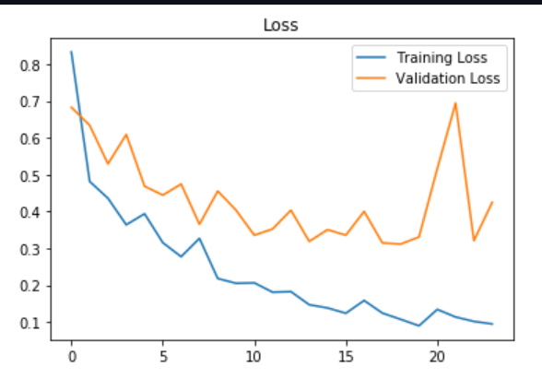
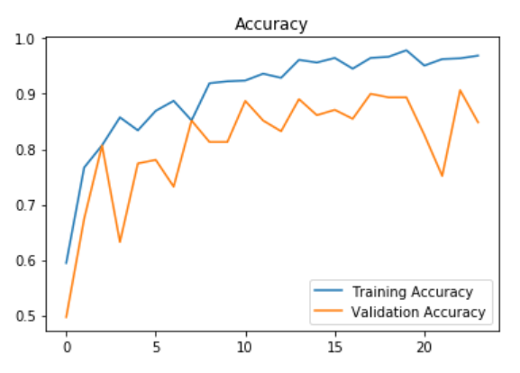
Discussion
The model was trained for 24 epochs and these are the loss & accuracy plots:
The best validation accuracy was achieved on the 23rd iteration.
The best model (the one with the best validation accuracy) detects brain tumor with:
 | Validation Set | Test Set
Accuracy | 91% | 89%
F1 Score | 0.91 | 0.89

Slide 14
Future Work
We can infer the effects of each detected tumour cell depending on the size and its seriousness.
Fine-tune the model: Fine-tuning involves re-training the CNN model on a smaller dataset of brain MRI scans. This can help the model learn more specific features related to brain tumors and improve its performance.
Use attention mechanisms: Attention mechanisms can be used to focus the CNN model's attention on the most important features of the brain MRI scans. This can improve the model's accuracy by reducing the impact of noisy or irrelevant features.

Slide 15
https://www.arm.com/glossary/convolutional-neural-network
References
https://www.geeksforgeeks.org/intuition-of-adam-optimizer/
https://www.tensorflow.org/tutorials/images/cnn
https://www.simplilearn.com/tutorials/deep-learning-tutorial/rnn

Slide 16
Thank You

